Slide 1

Effects of Crisis/Conflicts on Countries Data Modeling Project
Geographic Scope: 5 Countries
Region: Middle east
Notes:
Rayan: Page 1 to Page 9

Slide 2
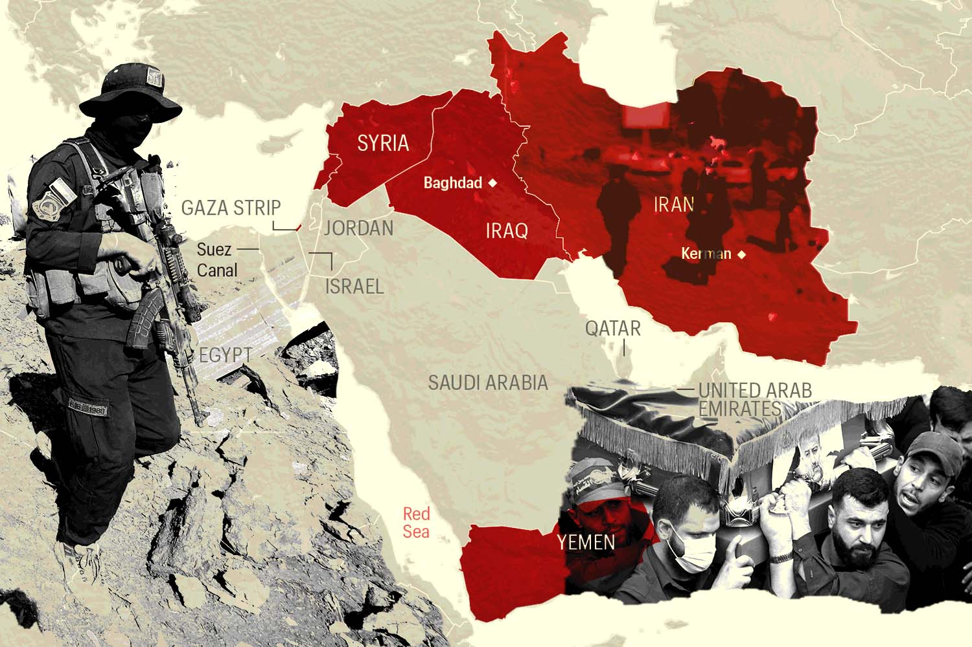
Team 1 - members
Hisham Khraibah 040985922
Rayan Haidar 041268172
Hala Abdel Rahman 041010280
Youssra Ibrahim 041010280
Joseph Alexius Tapang 041146039
STOP Wars
2

Slide 3
PROBLEM OVERVIEW
Political disagreements can escalate into conflicts or wars, disrupting country stability
Conflicts impact multiple sectors including economic, humanitarian, and infrastructure systems
Project analyzes conflict effects using anonymized, data-driven approach
Focus areas: Economic impact, Humanitarian impact, Infrastructure damage, Events, International aid & response
Goal: Understand impacts of conflict to support better insights and decision-making
STOP Wars

Slide 4
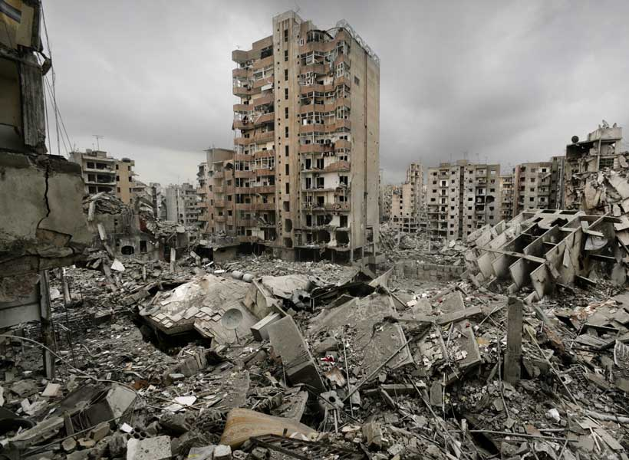
5 Business problems
Team Members & Roles:
1-Hisham
2-Rayan
Humanitarian Impact Analysis
3-Youssra
Conflict Parties and Actor Analysis
Economic Impact Analysis
4-Hala
5-Joseph
Infrastructure Damage Analysis
International Response and Aid Analysis

Slide 5

Data Sources
Key Data Categories | Columns To Generate
Event details, actors, locations | Economic Impact: sector classification, business damage, trade disruption
Economic, humanitarian, infrastructure impacts | Humanitarian Impact: displacement types, vulnerable groups, critical needs Infrastructure Damage: facility types, damage severity, service disruption
International responses and aid flows | International Response: aid organizations, diplomatic actions, media coverage Conflict Analysis: legal frameworks, weapon types, civilian harm assessment
Primary Source: ACLED (Armed Conflict Location & Event Data)
Link: https://acleddata.com/
11 years of data (January 2015 - March 2025)
5 country focus: Country A, Country B, Country C, Country D, Country E

Slide 6
What We Achieved

Slide 7
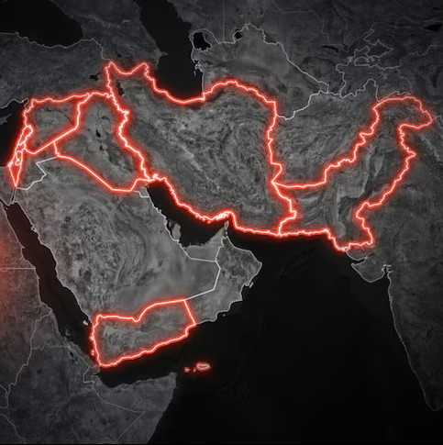
Phase 1
Define five business problems
Design fact and dimension tables for each problem
Generate the dataset columns required for each business scenario

Slide 8
Phase 2
Dataset: ACLED
Columns: 119, Records: 3000
Grain: One conflict event per country in a time per row
Created the 5 schemas for 5 Business Processes
Connected the 5 schemas with conformed dimensions.
Conformed: Dim_time, Dim_location

Slide 9
Phase 3
Fixed Joseph’s schema by changing the Actor Dimension to role play dimension
Develop DAX measures and calculations
Design interactive Power BI dashboards
5 Dashboard for each Business Process
1 overall Dashboard for the project

Slide 10
Fact & Dimensions
Notes:
Hala: Page 10 to Page 16

Slide 11
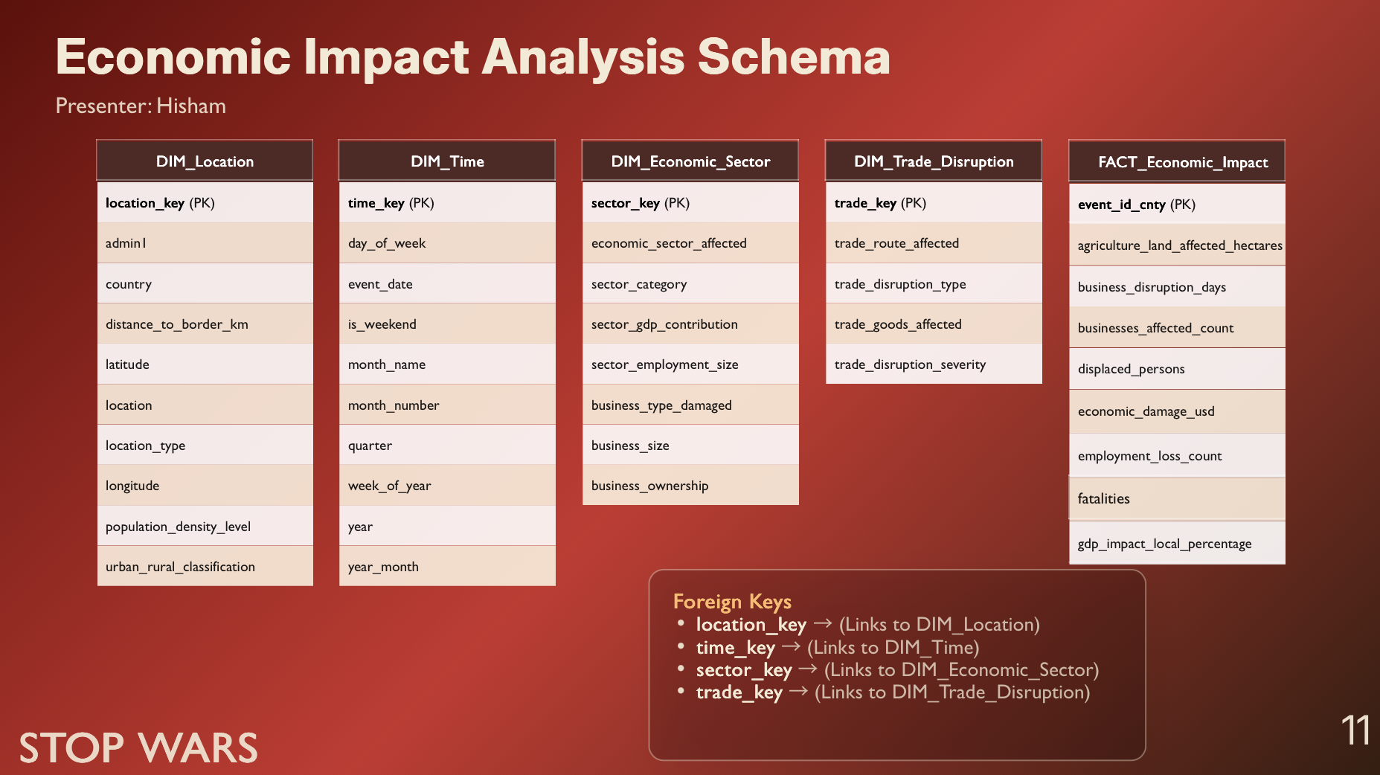

Slide 12
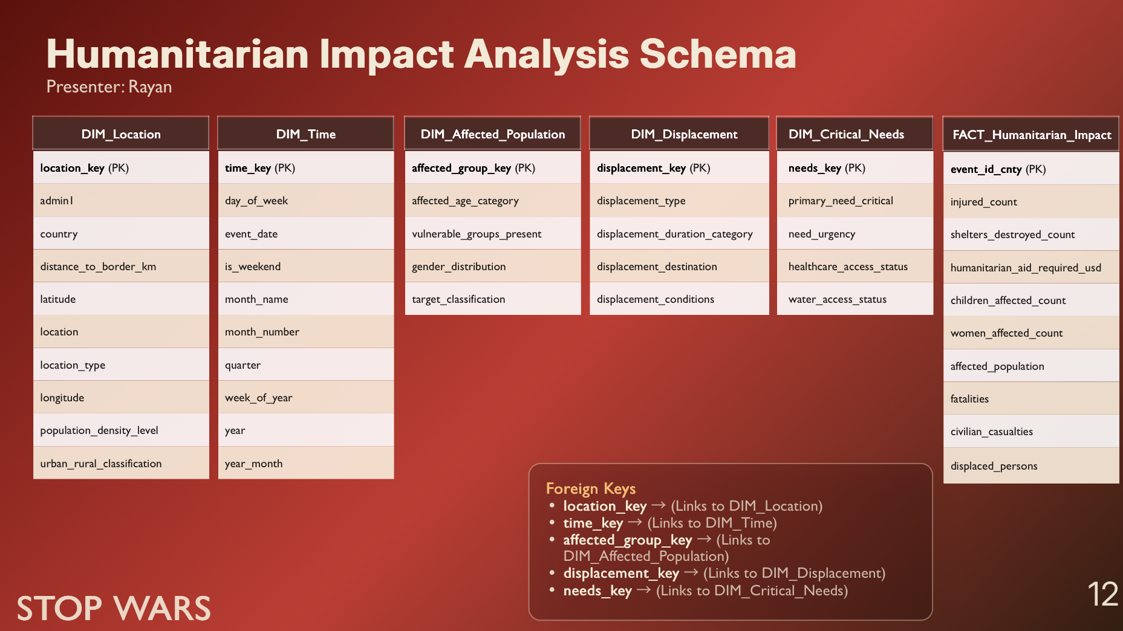

Slide 13
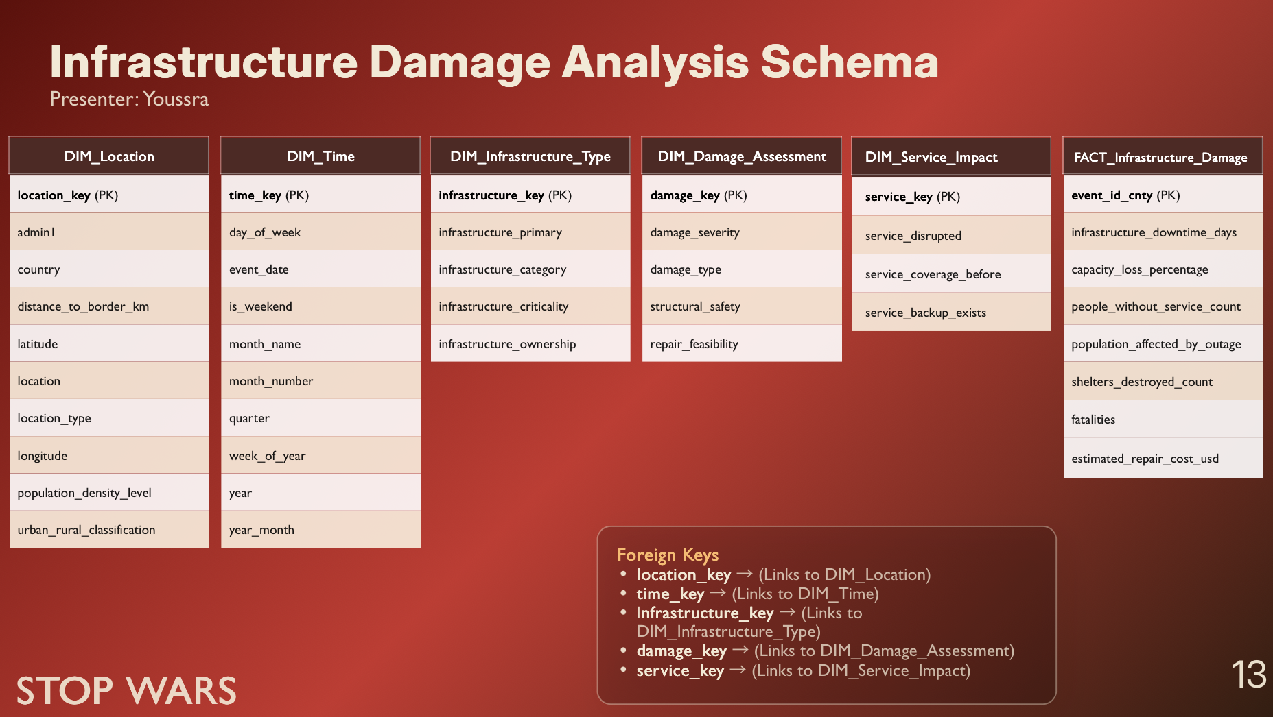

Slide 14
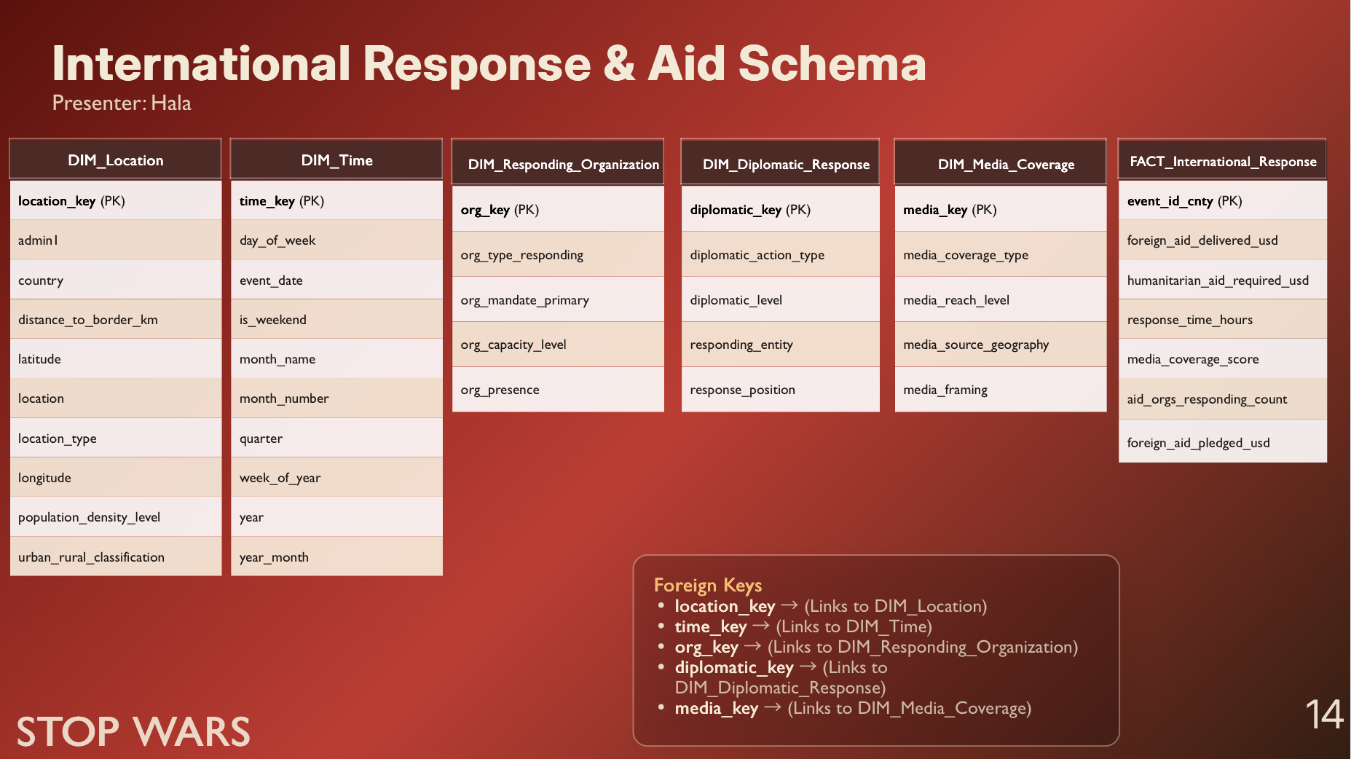

Slide 15
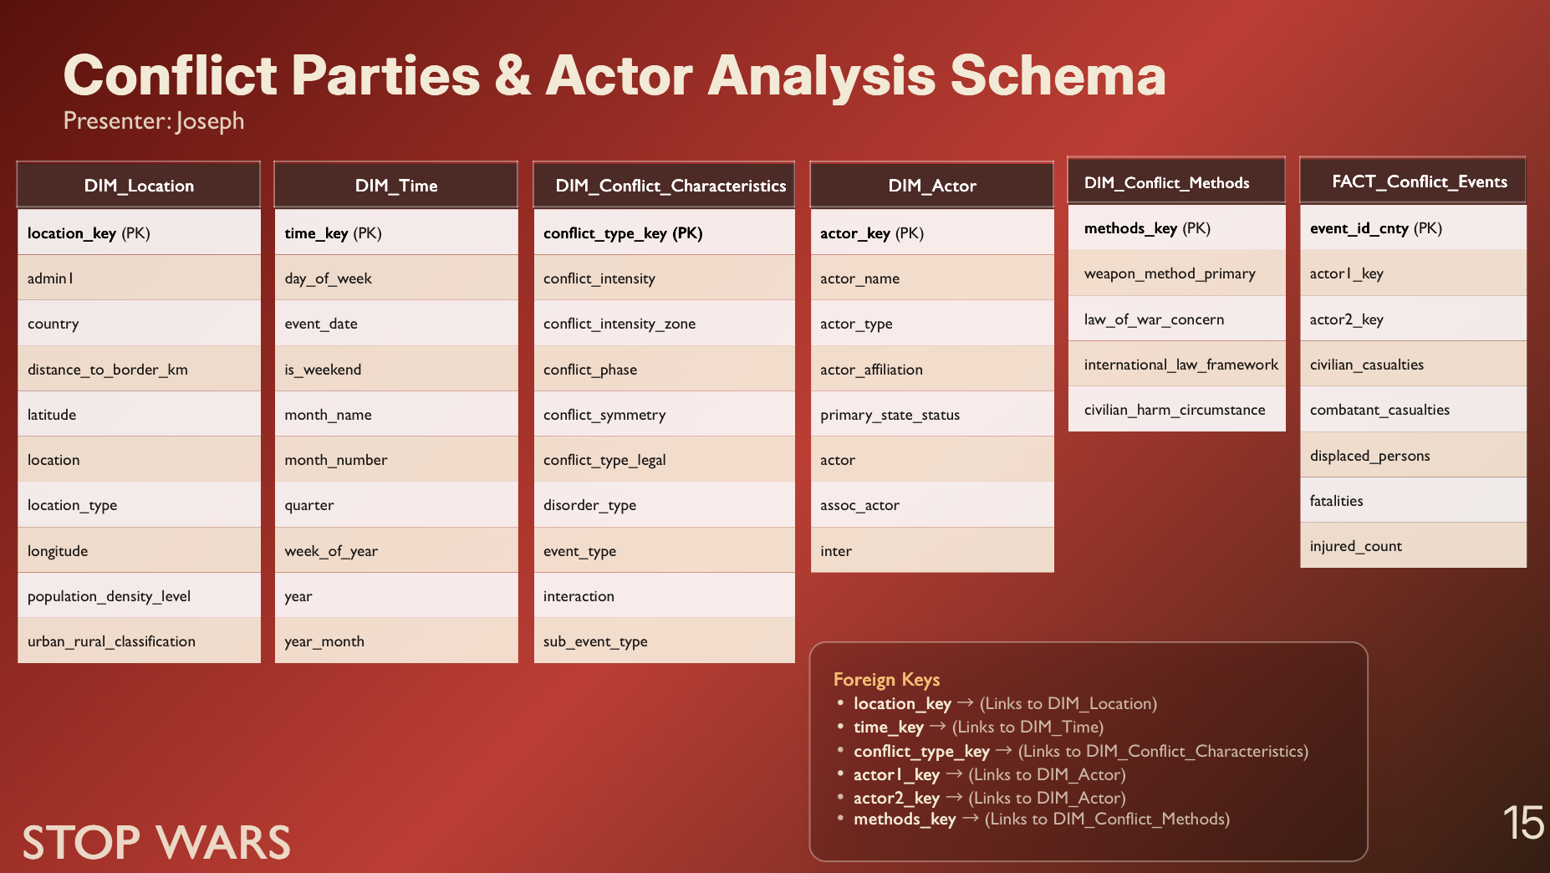

Slide 16
Dimensional Modeling Approach
Conformed Dimensions (Time & Location)
Standardized dimensions: shared across all schemas for consistent analysis
Time Dimension: supports trend analysis (day, month, year)
Location Dimension: enables geographic analysis (country, region)
Role-Playing Dimension (Actor)
A single dimension used in different roles in the model
Includes Primary Actor and Secondary Actor
Helps analyze different conflict participants and their roles

Slide 17
Models
Notes:
Hisham: Page 17 to Page 22

Slide 18
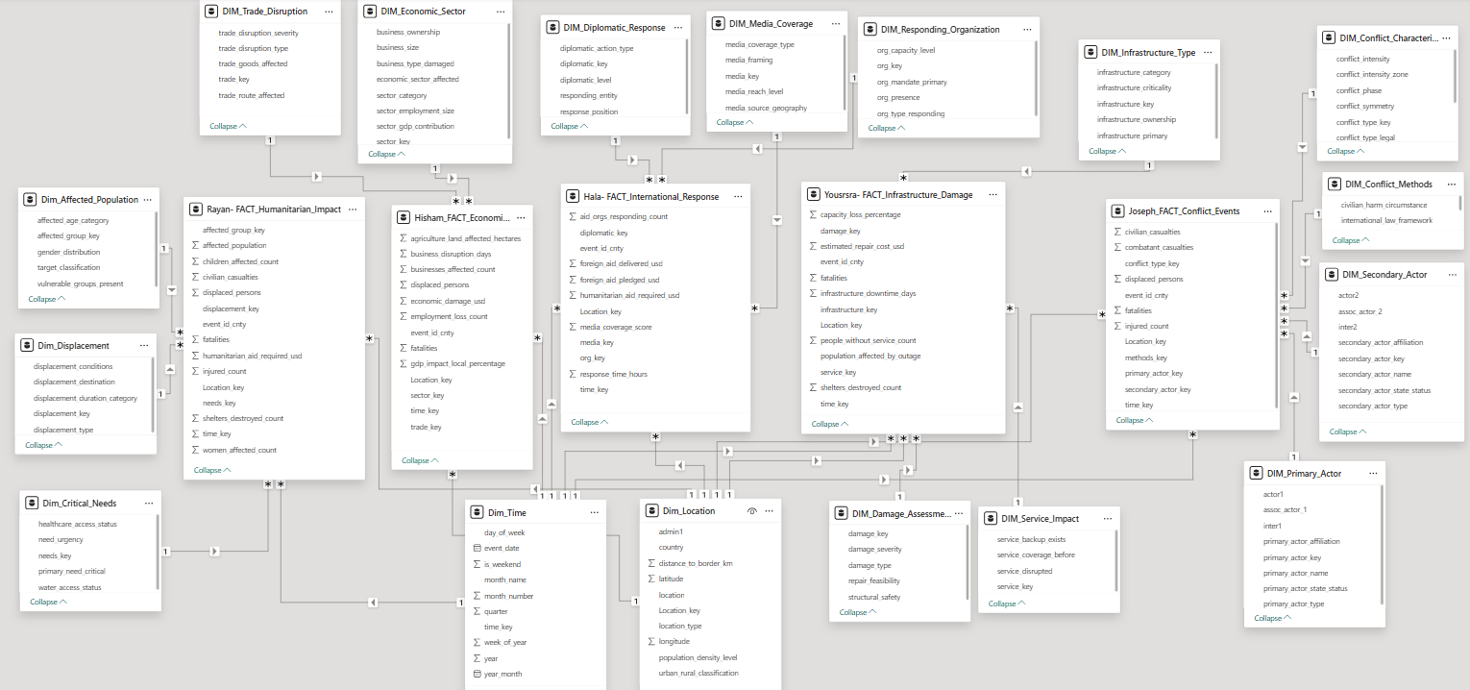
Snowflake schema

Slide 19
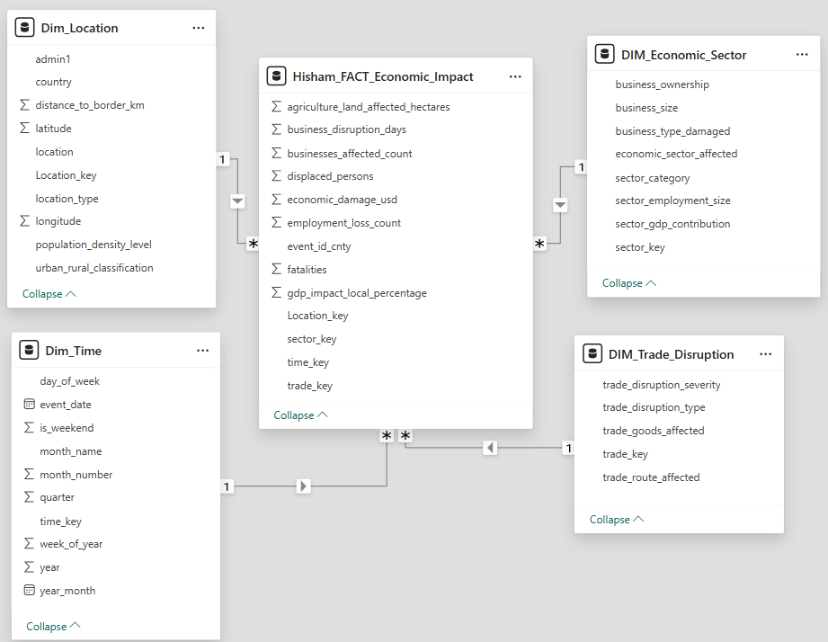
Hisham star schema

Slide 20
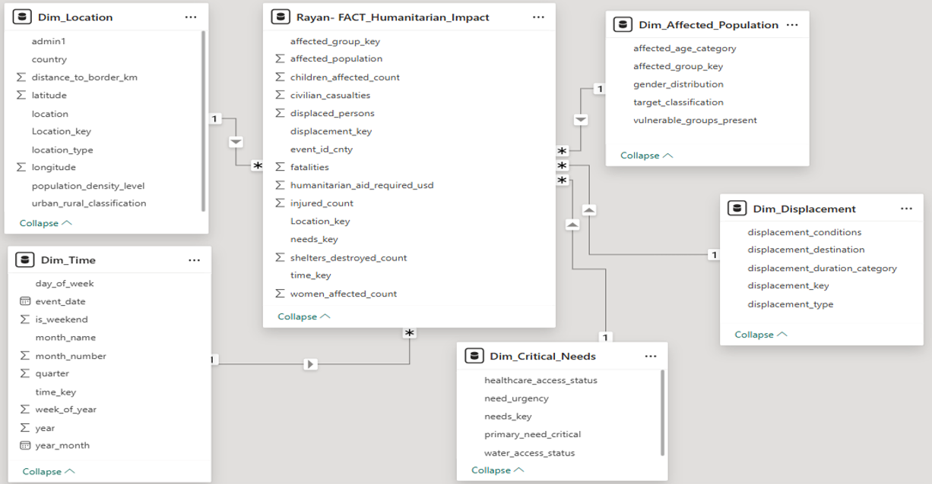
Rayan star schema

Slide 21
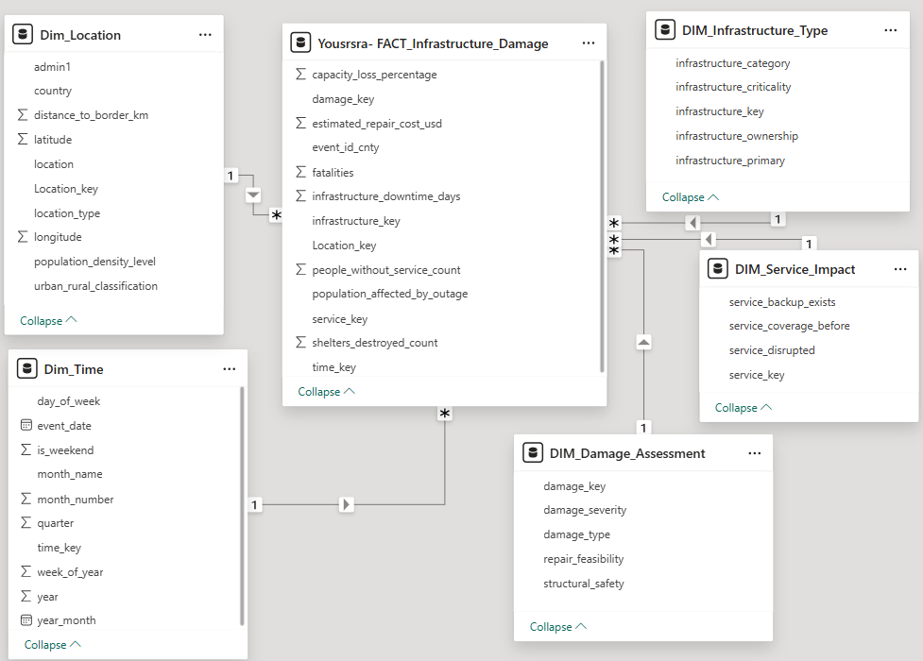
Youssra star schema

Slide 22
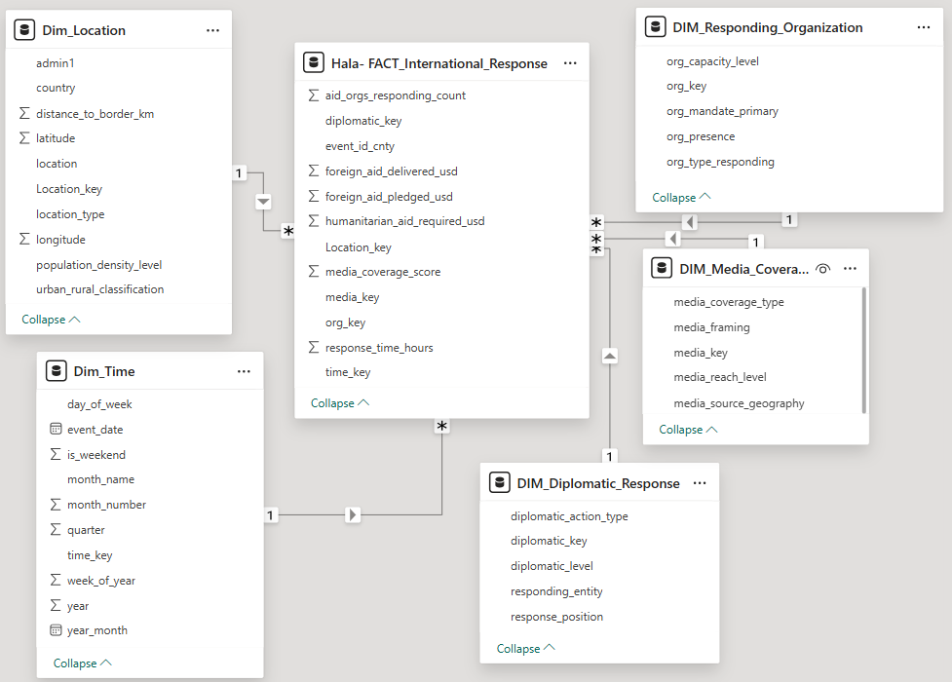
Hala star schema

Slide 23
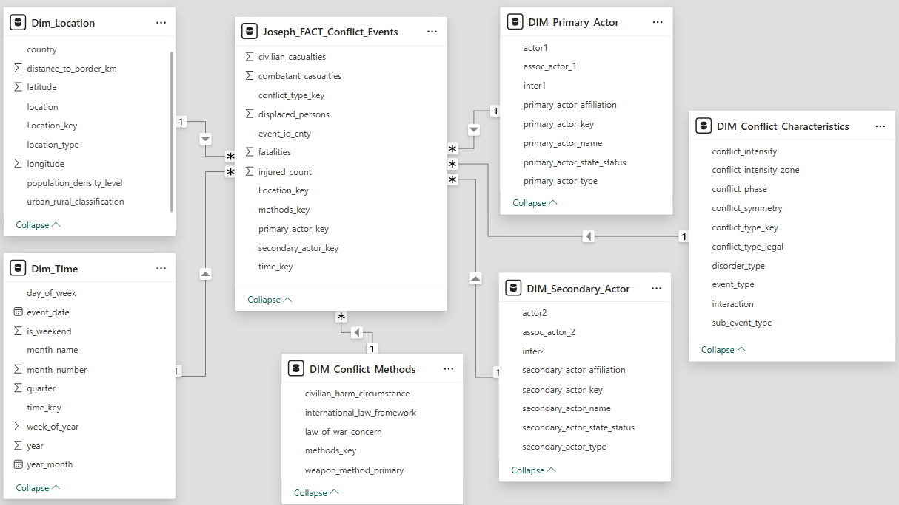
Joseph OLD star schema
Notes:
Joseph: Page 23 to Page 27

Slide 24
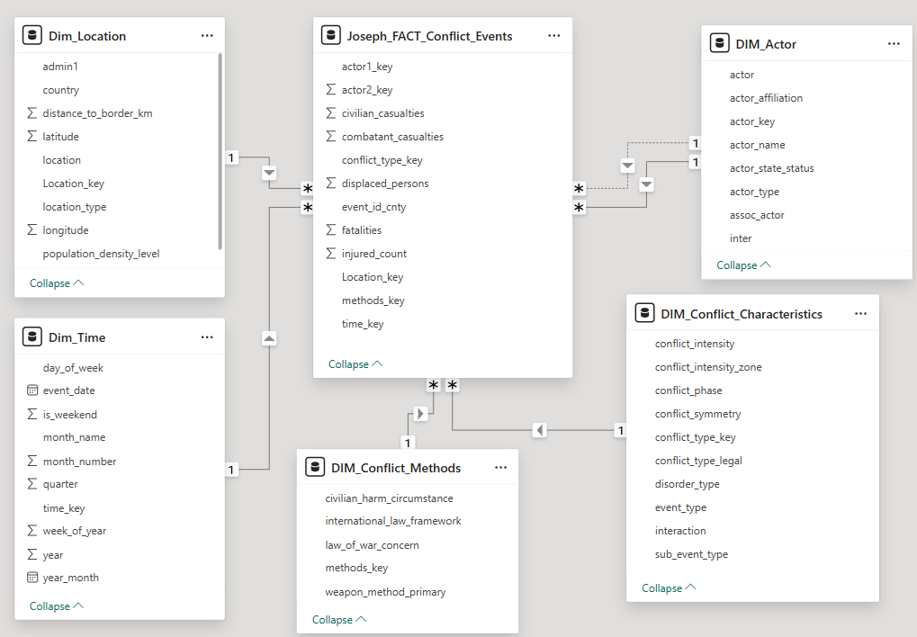
Joseph New star schema

Slide 25
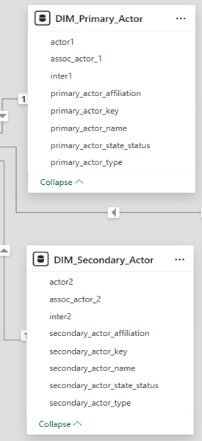
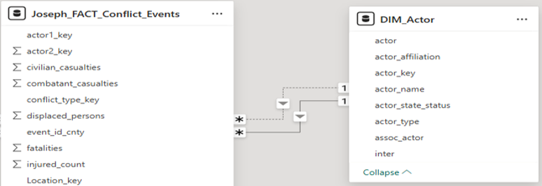
Joseph schema Changes
Schema Optimization: Actor Dimension Redesign
Replaced two separate tables (Primary Actor & Secondary Actor) with a single unified DIM_Actor table
Implemented a role-playing dimension to represent both actor roles (Primary & Secondary)
Added two foreign keys in the Fact table:
actor1_key → Primary Actor
actor2_key → Secondary Actor
Established two relationships between Fact and DIM_Actor:
One active relationship (used by default in analysis)
One inactive relationship (activated when needed using DAX)
Enabled flexible analysis of both actors without duplicating dimension tables
Reduced data redundancy and model complexity
Improved scalability and maintainability of the schema
Old dimensions
New Role-Play Dimension

Slide 26
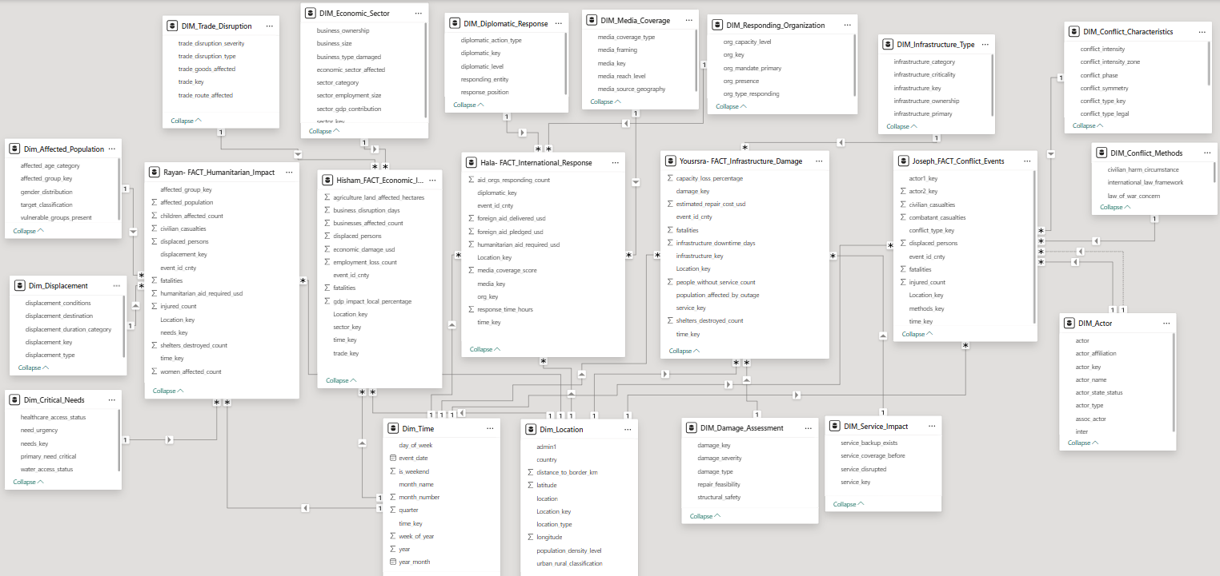
Updated Snowflake schema

Slide 27
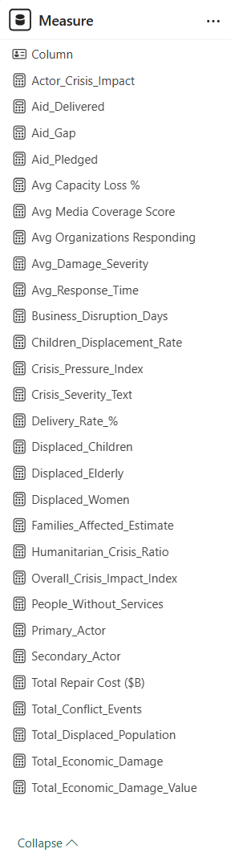
DAX Measures
Total number of DAX measures created: 28
Here are 5 sample of DAX measures:
Total_Economic_Damage_Value =
SUM(Hisham_FACT_Economic_Impact[economic_damage_usd])
Displaced_Elderly =
CALCULATE(
SUM('Rayan- FACT_Humanitarian_Impact'[affected_population]) -
SUM('Rayan- FACT_Humanitarian_Impact'[children_affected_count]) -
SUM('Rayan- FACT_Humanitarian_Impact'[women_affected_count]))
People_Without_Services =
SUM('Yousrsra- FACT_Infrastructure_Damage'[people_without_service_count])
Avg Organizations Responding =
AVERAGE('Hala- FACT_International_Response'[aid_orgs_responding_count])
Total_Conflict_Events =
COUNT(Joseph_FACT_Conflict_Events[event_id_cnty])

Slide 28
Dashboards
Notes:
Youssra: Page 28 to Page 36

Slide 29
Interactive Dashboards Features
COLOR SCHEME (UNIFIED DASHBOARD THEME-RED):
All Dashboards Uses UNIFIED COUNTRY COLORS
Red Spectrum: #C50F1F, #F7630C, #8B0000
Consistent with crisis urgency and vulnerability hierarchy
Color blind accessible with distinct contrast levels
INTERACTIVITY FEATURES (CROSS-DASHBOARD):
DRILL-DOWN HIERARCHY: Country → Crisis Type → Time Period
CROSS-FILTERING SETUP:
Click country bar → Filters entire dashboard to that country
Click legend item → Highlights that demographic across ALL 5 team visuals
Click specific segment → Filters to that demographic + country combination
Synchronized with Hisham, Rayan, Youssra, Hala, Joseph charts
Bidirectional filtering enabled
All dashboards' visuals include the feature once the user select a visual, all information will be displayed

Slide 30
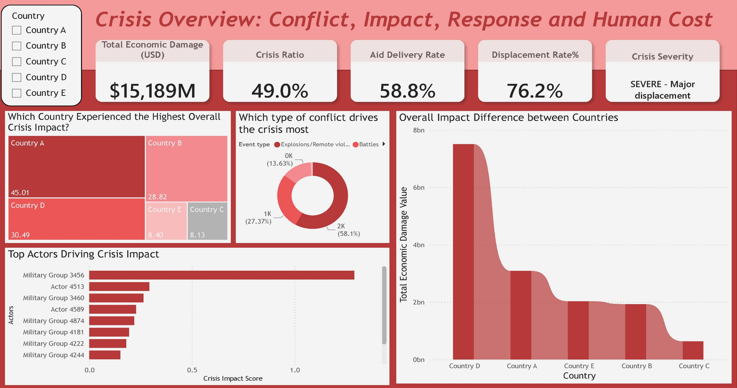
Overall Dashboard

Slide 31
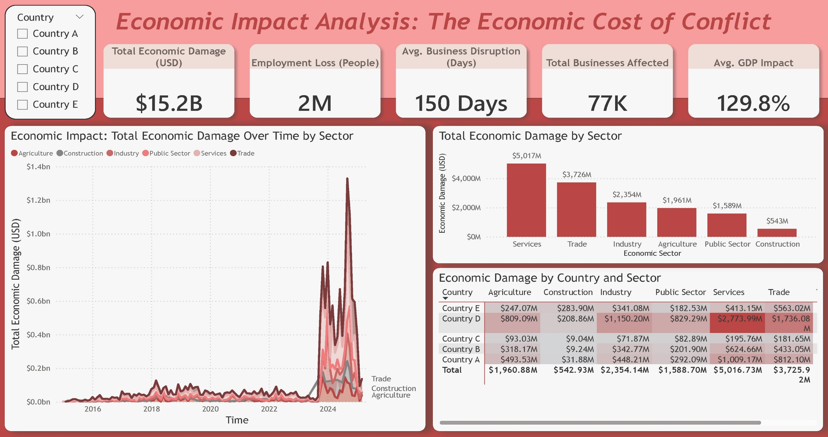
Hisham’s Dashboard

Slide 32
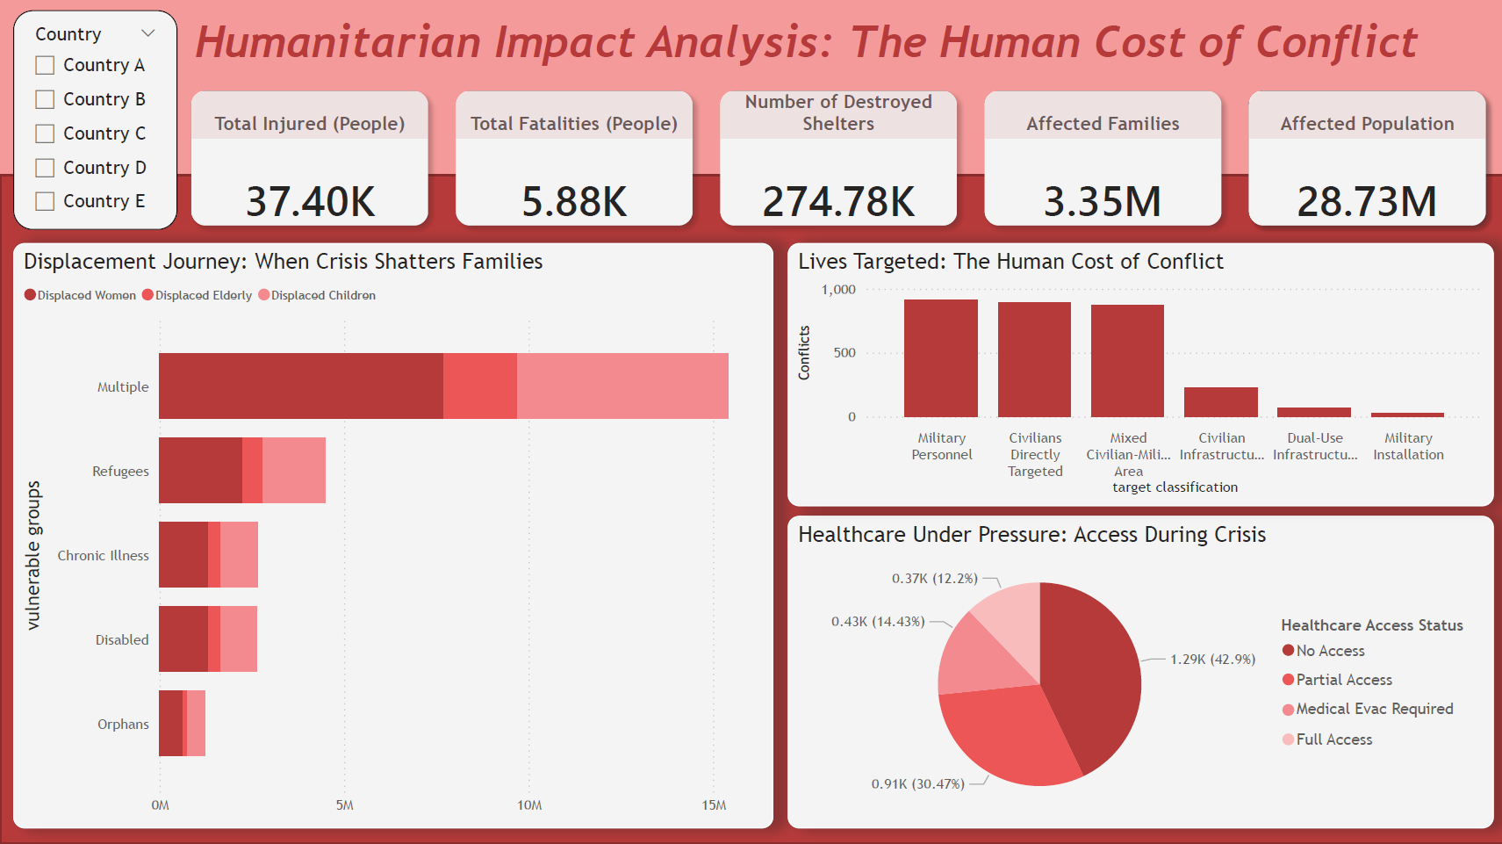
Rayan’s Dashboard

Slide 33
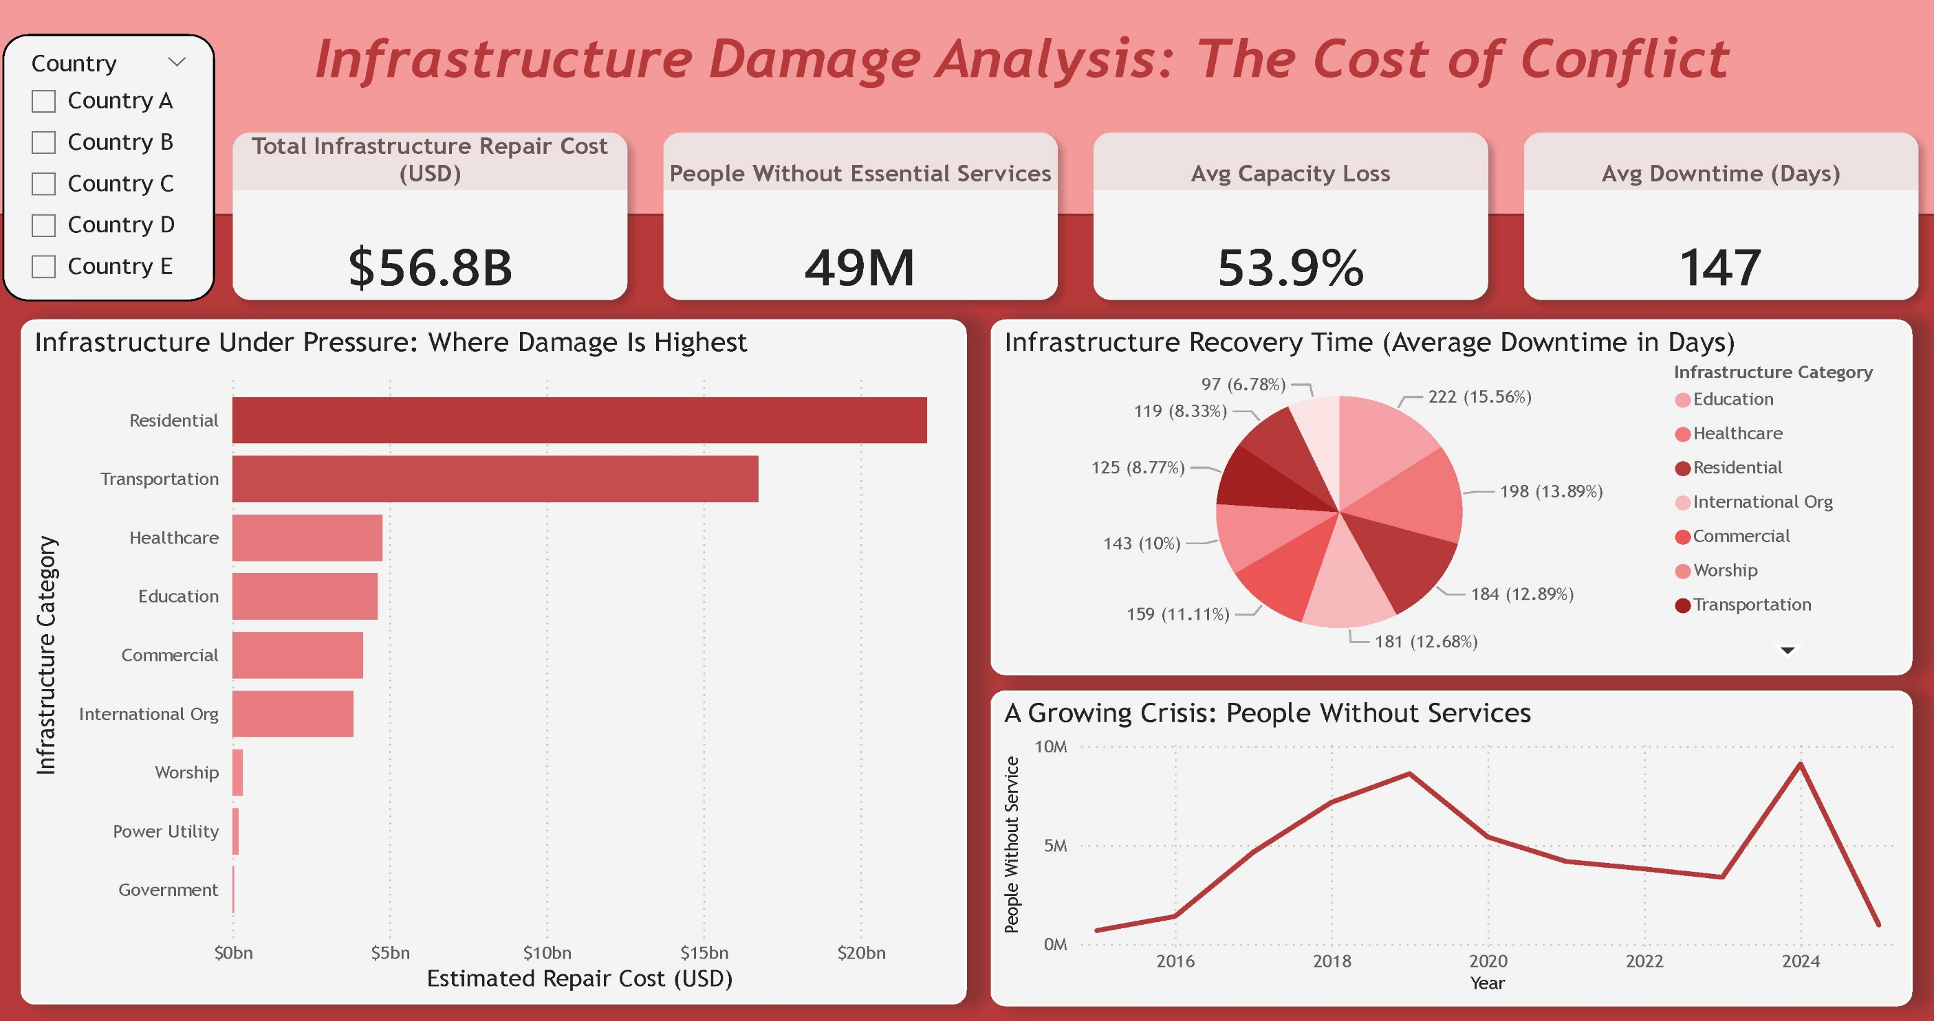
Youssra’s Dashboard

Slide 34
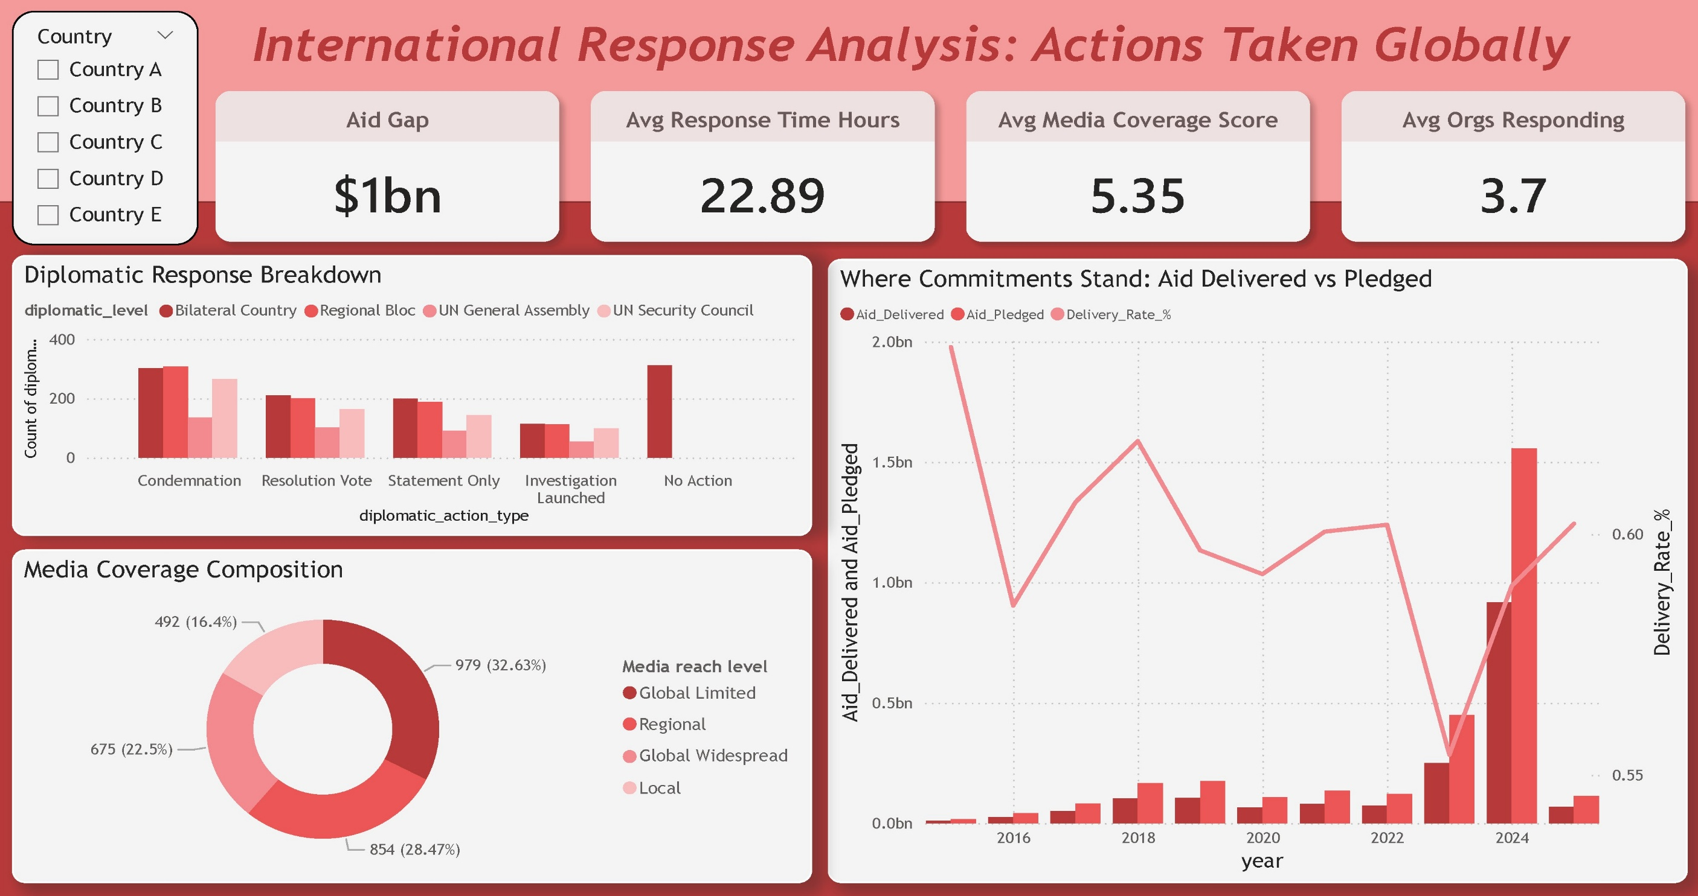
Hala’s Dashboard

Slide 35
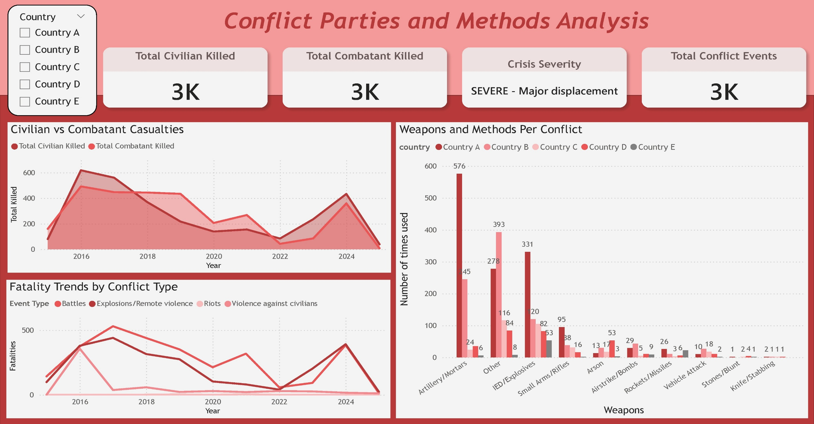
Joseph’s Dashboard

Slide 36
Power BI Demo

Slide 37
THANK YOU!
ANY QUESTIONS?

